Slide 1
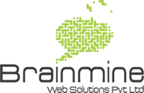
DIGITAL MARKETING GUIDE
The Complete Guide to Digital Marketing
LEARN WITH BRAINMINE

Slide 2
Digital Marketing
What is Digital Marketing?
Digital marketing, also called online marketing, refers to all marketing efforts that occur on the internet. Businesses leverage digital channels such as search engines, social media, email, and other websites to connect with current and prospective customers. This also includes communication through text or multimedia messages.
Digital marketing helps you reach a larger audience than you could through traditional methods, and target the prospects who are most likely to buy your product or service. Additionally, it's often more cost-effective than traditional advertising, and enables you to measure success on a daily basis and pivot as you see fit.
What are the types of Digital Marketing?
Here are five of the most effective types of digital marketing:
Content Marketing - Content marketing is a strategic marketing approach focused on creating and distributing valuable, relevant, and consistent content to attract and retain a clearly defined audience — and, ultimately, to drive profitable customer action.
Search Engine Optimization - SEO is the process of improving your site to increase its visibility when people search for products or services related to your business in Google, Bing, and other search engines. The better visibility your pages have in search results, the more likely you are to garner attention and attract prospective and existing customers to your business.

Slide 3
Digital Marketing
Pay Per Click - PPC is an online marketing model. This form of advertising is prevalent and most closely associated with Google, though you can see PPC ads on Facebook, Bing, and other places as well. With PPC marketing, the advertiser has to pay a fee every time someone clicks on their ad — hence the name pay-per-click.
Social Media Marketing - Social media marketing is the process of creating content for social media platforms to promote your products and/or services, build community with your target audience, and drive traffic to your business. With new features and platforms emerging every day, social media marketing is constantly evolving.
Email Marketing - Email marketing is a powerful marketing channel, a form of direct marketing as well as digital marketing, that uses email to promote your business’s products or services. It can help make your customers aware of your latest items or offers by integrating it into your marketing automation efforts.
Influencer Marketing - Influencer marketing is a way brands can promote their products through endorsements or recommendations from influencers and content creators on the internet. Social media and blogs are home to the majority of
influencers, although other creators like podcast hosts can fit the bill, too. Many times, influencer marketing is a part of brand awareness campaigns, but it can also result in plenty of conversions and sales.

Slide 4
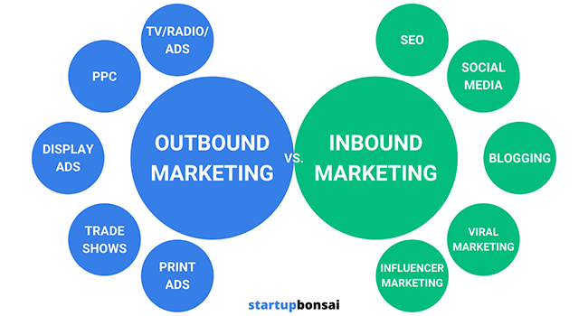
Digital Marketing
Explain Inbound and Outbound Marketing?
Outbound marketing is a traditional method of marketing seeking to push messaging out to potential customers. Outbound marketing includes activities such as trade shows, seminar series, and cold calling. It is costly and the ROI is much lower than inbound marketing.
Inbound marketing is a strategy where you create content or social media tactics that spread brand awareness so people learn about you, might go to your website for information, show interest in your product, and potentially make a purchase.

Slide 5
Digital Marketing
What is SEO? Why SEO is important for Marketing?
To understand the value of SEO, let's break our definition into three parts:
Organic Search Results: the unpaid listings on a search engine results page (SERP) that the search engine has determined are most relevant to the user’s query. Ads (in this context, PPC or pay-per- click ads) make up a significant portion of many SERPs. Organic search results are distinct from these ads in that they are positioned based on the search engine’s organic ranking algorithms rather than advertiser bids. You can’t pay for your page to rank higher in organic search results.
Quality of Organic Traffic: how relevant the user and their search query are to the content that exists on your website. You can attract all the visitors in the world, but if they're coming to your site because Google tells them you're a resource for Apple computers when really you're a farmer selling apples, those visitors are likely to leave your site without completing any conversions. High-quality traffic includes only visitors who are genuinely interested in the products, information, or other resources your site offers. High-quality SEO capitalizes on the search engine’s effort to match a user’s search intent to the web pages listed in the SERP.
Quantity of Organic Traffic: the number of users who reach your site via organic search results. Users are far more likely to click on search results that appear near the top of the SERP, which is why it’s important to use your SEO strategy to rank relevant pages as highly as you can. The more high-quality visitors you attract to your site, the more likely you are to see an increase in valuable conversions.

Slide 6
Digital Marketing
What is Search Engine? How do search engines actually work? Search engines are tools that find and rank web content matching a user’s search query. Each search engine consists of two main parts:
Search index. A digital library of information about web pages.
Search algorithm(s). Computer program(s) that rank matching results from the search index.
Examples of popular search engines include Google, Bing, and DuckDuckGo.
There are three steps to how search engines work: crawling, which is the discovery stage; indexing, which is the filing stage; and ranking, which is the retrieval stage.
Crawling - It is the discovery process in which search engines send out a team of robots (known as crawlers or spiders) to find new and updated content. Content can vary — it could be a webpage, an image, a video, a PDF, etc. — but regardless of the format, content is discovered by links.
Indexing (How do search engines interpret and store your pages?) - Store and organize the content found during the crawling process. Once a page is in the index, it’s in the running to be displayed as a result to relevant queries.
Ranking - When someone performs a search, search engines scour their index for highly relevant content and then orders that content in the hopes of solving the searcher's query. This ordering of search results by relevance is known as ranking. In general, you can assume that the higher a website is ranked, the more relevant the search engine believes that site is to the query.
Learn more - https://moz.com/beginners-guide-to-seo/how-search-engines-operate

Slide 7
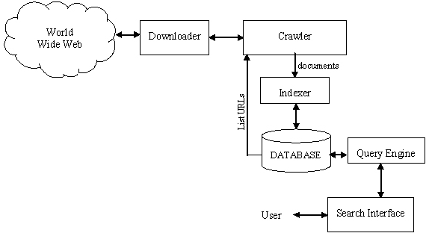
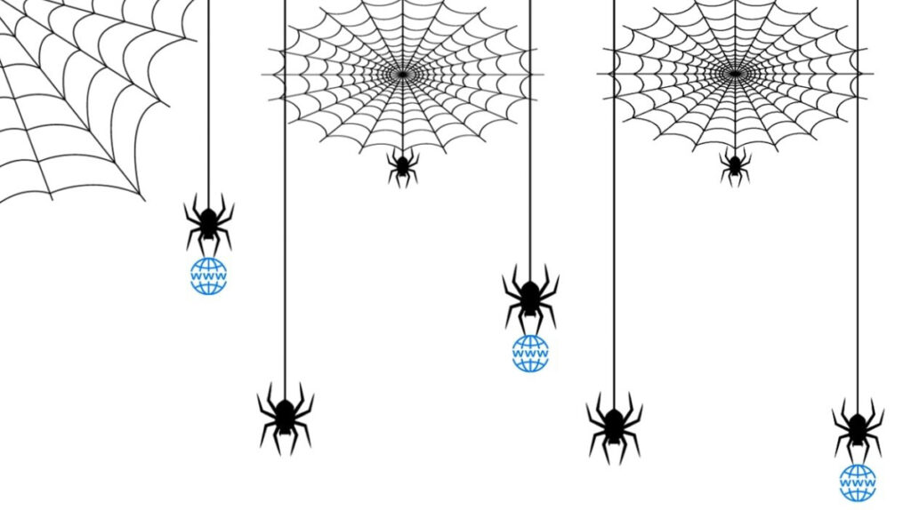
Digital Marketing
What is Google Algorithm & How Search algorithms work?
The Google search algorithm refers to the internal process that Google uses to rank content. With the amount of information available on the web, finding what you need would be nearly impossible without some help sorting through it. Google ranking systems are designed to do just that: sort through hundreds of billions of web pages in our Search index to find the most relevant, useful results in a fraction of a second, and present them in a way that helps you find what you’re looking for. These ranking systems are made up of not one, but a whole series of algorithms. To give you the most useful information, Search algorithms look at many factors, including the words of your query, relevance and usability of pages, expertise of sources, and your location and settings.

Slide 8
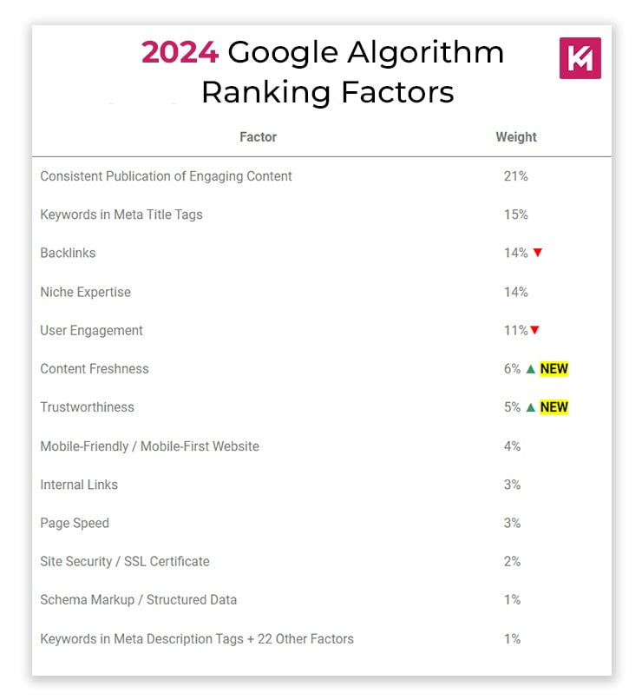
Digital Marketing
What are the SEO Ranking Factors?
Content
Mobile Friendly Website | Responsive Website
Page Experience (Site Architecture)
Page Speed
On -Page Optimization
Internal Site Structure
Backlinks
Local SEO
Domain Authority

Slide 9
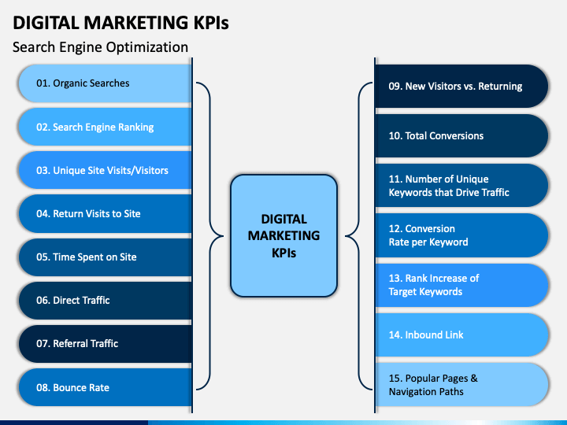
Digital Marketing
What is KPI? List down the SEO KPIs you need to track.
Goals and KPIs are among the most important parts of your SEO strategy. Without KPIs, you will not be able to effectively track your campaign’s progress and ensure that your efforts are paying off or determine if you are on the right track towards success. So, KPIs are objective metrics that help to measure and give clarity into the success of a given organization or campaign. To learn in detail, visit - https://www.semrush.com/blog/seo-kpis/
Following are the most important KPIs you should be using -
ROI
Conversions (Sales and Leads)
Organic Visibility
Organic Sessions
Branded vs. Non-Branded Traffic
Keyword Rankings
Backlinks
Organic CTR
Bounce Rate
Average Time on Page
Coverage Issues
PageSpeed

Slide 10
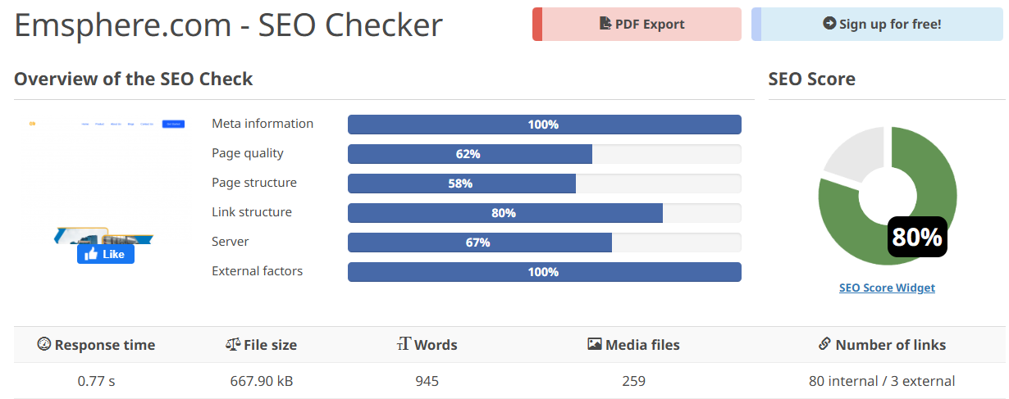
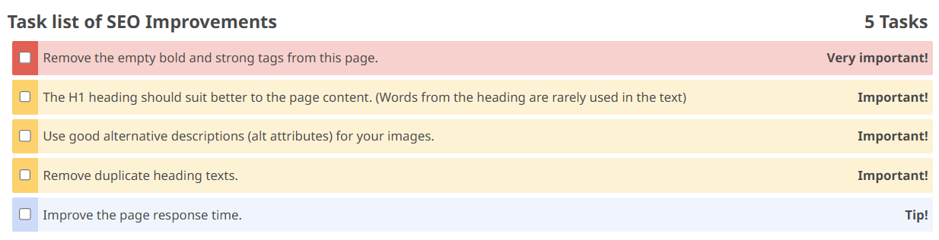
SEO Tools Analysis- https://www.emsphere.com/
1. SEO ability:
Optimize the website every month and ensure that its score always remains above 75%.

Slide 11
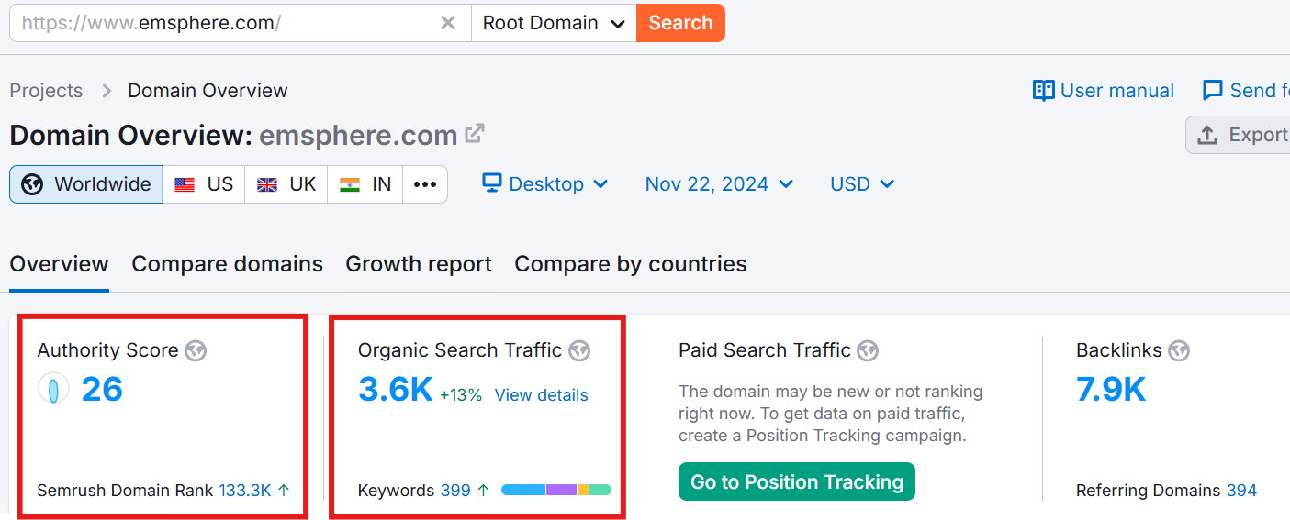
Semrush Audit- https://www.emsphere.com/
Current Status:
Actionable Step:
Quality content on Website
On-page SEO
Technical SEO
Keyword Research
Local SEO
Guest Blogging
Clear CTAs
Improving UI/UX of website
Quality Backlink Building
Content Marketing Strategy

Slide 12
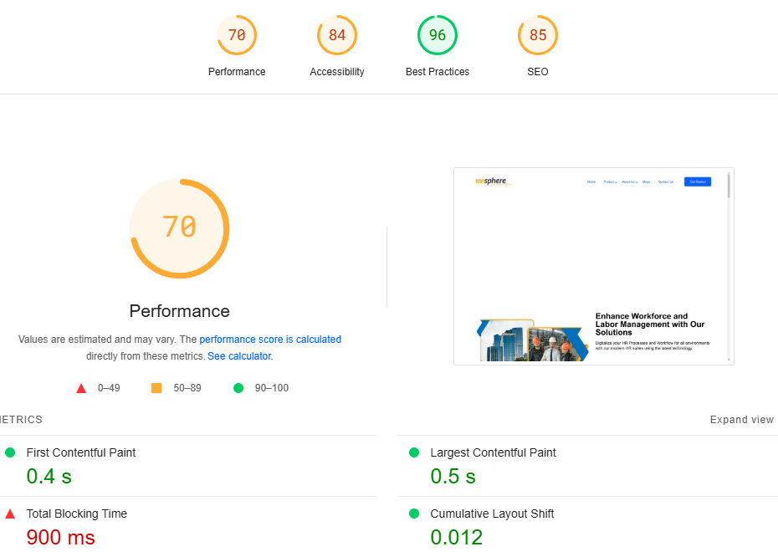
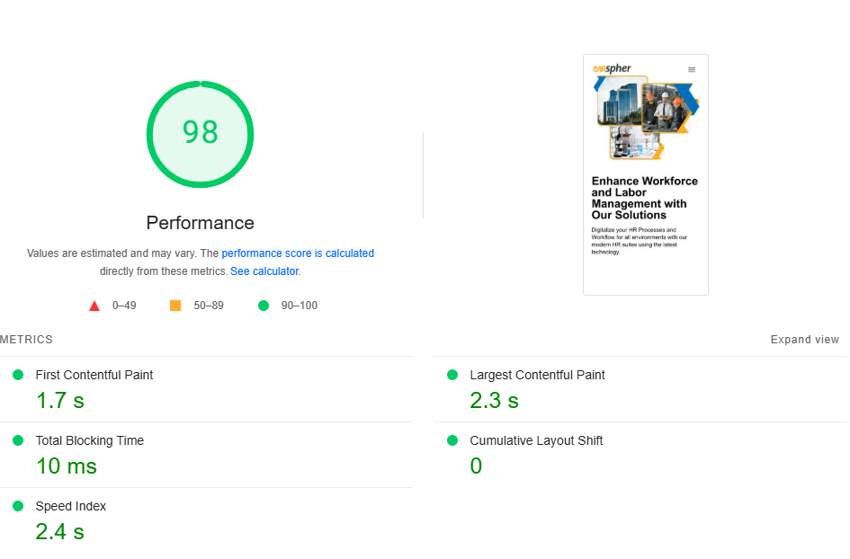
Website Speed Optimization- https://www.emsphere.com/
Desktop Performance Score: 70
The performance score indicates moderate speed, but there is room for improvement.
Recommended Score: Above 80
Mobile Performance Score: 98

Slide 13
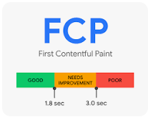
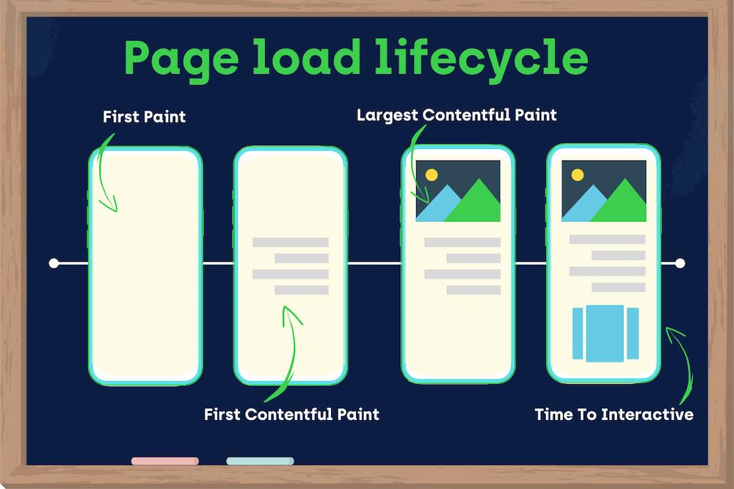
Diagnostics for Speed Optimization
First Contentful Paint Test:- In plain way, FCP is when the user can see some part of your page change. Often, this comes as a header bar or background image.
To provide a good user experience, Google recommends that sites should strive to have a First Contentful Paint value of 1.8 seconds or less.
Largest Content ful Paint Test:- A web performance indicator that measures how quickly the main content of a website becomes visible to users.To provide a good user experience, Google recommends that sites should strive to have
Largest Contentful Paint of 2.5 seconds or less.

Slide 14
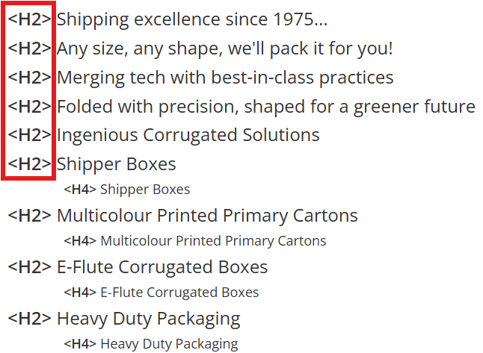
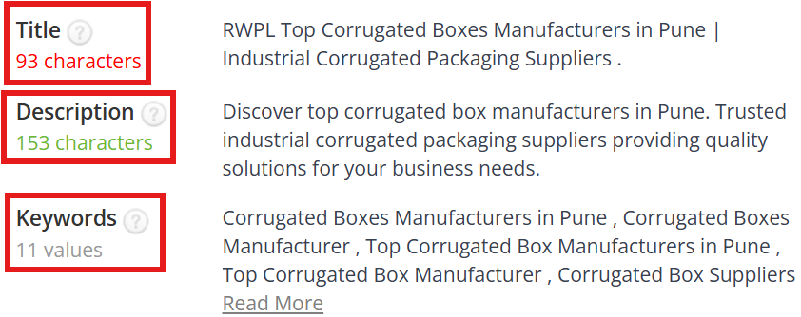
On-Page SEO Recommendation
Home page - https://www.radheshamwellpack.com/
Title - 93 characters - recommended under 55 to 60 characters
Description - 153 Characters - recommended 155 to 160 characters
Keywords - We are targeting multiple keywords on a single page. We should try to focus on one main keyword and its alternative keywords per page.
The heading structure of the website is not correct. The headings are not following a proper hierarchy. Headings should start from H1 and go up to H6, Our homepage has H2 tag but they are not in proper structure and even H1 is missing. We have total 24 H2 Tags. We need to optimise the heading structure to improve the ranking.

Slide 15
Scope of Work
Technical Activities |  | On-Page Activities |  | Backlinks Activities
Broken Pages/Resources |  | Optimizing Meta Title |  | Social Bookmarking
Broken Images |  | Optimizing Meta Description |  | Directory Submission
Dynamic URLs Resolution |  | Implementing Rich Snippet/Schema |  | Local Citation
Image Compression |  | Optimizing Image Alt Text |  | Profile Creation
Script Issues - Java and CSS Resolution |  | URL Structure Review and Suggestions |  | Web 2.0
Page Loading Speed |  | Content Optimization |  | Classified Ads
Duplication Issues |  | Optimizing Internal Linking |  | Quora
Canonical Issues |  | Header Tags Setup |  | Reddit
Redirection Issues (HTTPS & WWW) |  | CTA Review and Suggestions |  | Forums (niche)
Robots.txt and Sitemap.xml |  | Home page UI/UX changes |  | Blog Commenting
Setting up Tracking |  | Internal Link Optimization |  | Web 2.0 SB
Workable Link Structure (Social icons/policy pages, etc.) |  |  |  | Social Site Sharing
 |  |  |  | Article Submission
 |  |  |  | PPT Creation * Submission
 |  |  |  | PDF Creation * Submission
 |  |  |  | Video Submission - Need Video from client
 |  |  |  | Infographics Creation * Submission
 |  |  |  | Competitor Backlinks
 |  |  |  | Guest Blogging *
 |  |  |  | Editorial *
 |  |  |  | Press Release *
Focusing on below matrix :
Search Visibility
Traffic
Content Syndication
Crawlability
Backlinks
Domain Authority

Slide 16
THANK YOU

